Slide 1

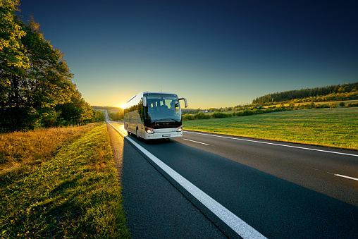
BUS RESERVATION SYSTEM
1NH21CS166 : NIKHIL SURYADEVRA
1NH21CS170 : N MAHITH KUMAR
1NH21CS175 : PATIL OMKAR

Slide 2
INTRODUCTION
Website allows users to make reservations and manage their bookings. The system should streamline the bus booking process for users and provide efficient management tools for administrators.
We Designed an intuitive and user-friendly website using HTML and CSS with a responsive design to ensure compatibility across various devices and screen sizes.

Slide 3
KEYWORDS
Online Booking: Allow users to book bus tickets online.
Seat Selection: Enable passengers to choose their preferred seats.
Route Selection: Display available routes and destinations.
Payment Options: Various payment methods for convenience.
Real-time Availability: Display real-time seat availability.
User Accounts: Sign-up, login, and profile management for users.
Notifications: Confirmation, reminders, and alerts via email or SMS.
Reviews and Ratings: Integration of passenger feedback.
Accessibility: User-friendly interface for all types of users.

Slide 4
METHODOLOGY
How It Works:
Step-by-step guide on how a user can make a reservation.
Overview of the booking process, seat selection, payment, and confirmation.
Benefits:
Convenience: Book from anywhere, anytime.
Time-Saving: Avoid long queues and waiting times.
Transparency: Real-time information about bus schedules and availability.
Choice: Select preferred seats and routes.
Cost-Effective: Compare prices and choose affordable options.

Slide 5
For Bus Operators:
Admin Dashboard: Manage routes, schedules, and bookings.
Analytics: Insights into booking trends and occupancy rates.
Resource Optimization: Efficient allocation of buses and resources.
Customer Support: Address passenger queries and issues.
Challenges and Solutions:
Address potential challenges in implementing a Bus Reservation System.
Provide solutions or strategies to overcome these challenges.

Slide 6
Future Enhancements:
Discuss potential future developments or features.
Integration with other transportation systems.
AI-powered recommendations for routes and schedules.
Security and Privacy:
Ensure passenger data security and privacy measures.
Compliance with data protection regulations.
Case Studies:
Showcase successful implementations of Bus Reservation Systems.
Highlight the positive impact on passenger experience and business operations.

Slide 7
CANCELLATION MODULE
Cancellation fee will be deducted from the passenger’s reservation amount.
Cancellation slabs(%fare fund) is based on the time of cancellation and departure time of the service at the place of boarding.
In case of partial cancellation,the seat no. of the passenger,accounts department of dreamtravel.com will refund the amount applicable to the concerned credit card/debit card/online banking account.
Refund to passengers will be given normally in 15 working days. After the cancellation of ticket of email. If dreamtravel.come troll free no.

Slide 8
REQUIREMENTS
1. Development Environment:- A computer with a text editor or integrated development environment for coding (e.g., Visual Studio Code, Sublime Text, Php Storm).
2. Web Technologies:- HTML, CSS, JavaScript for front-end development.
3. Web Hosting:
- A web hosting provider that supports PHP and MySQL databases.
- Access to Control Panel or a similar control panel for managing server settings, databases, and files.
4. Responsive Design:
- Design your website to be responsive, ensuring it works well on various devices and screen sizes.
5. Version Control:
- Version control system (e.g., Git) to track changes, collaborate, and manage codebase.

Slide 9
ALGORITHM:
User Registration and Login:
- Users can register with their email and password.
- Upon registration, store user information (name, email, password) In the MySQL database.
- Users can log in using their registered email and password.
User Dashboard:
- Upon successful login, users are directed to their dashboard. - The dashboard displays active and past bookings.
- Users can click on "Reserve a Seat" on the dashboard.
- Display a page showing the available seats for a selected bus journey.
- Retrieve seat availability data from the MySQL database.

Slide 10
Seat Selection:
- Display a graphical seat layout using HTML, CSS, and JavaScript.
- Highlight available seats and allow users to select seats.
- Update the seat layout in real-time as users make selections.
Confirm Reservation:
- After selecting seats, users can confirm their reservation.
- Validate the selected seats and display a confirmation message.
- Store the reservation details (user ID, seat numbers, date) in the database.
View Active and Past Bookings:
- Users can view their active and past bookings on the dashboard.
- Retrieve booking information from the database and display it on the dashboard.

Slide 11
Logout:
- Users can log out from the dashboard.
Users Table: - user_id (Primary Key)
- name
- email
Bookings Table:
- booking_id (Primary Key)
- user_id (Foreign Key referencing Users Table)
- booking_date.

Slide 12
CONCLUSION
The Bus Reservation System offers a comprehensive solution for passengers to easily and securely reserve bus seats, manage bookings, and access travel information. By combining HTML, SQL, PHP, JavaScript, and CSS, this system ensures a seamless user experience, efficient data management, and robust security measures, contributing to a hassle-free and user-centric bus travel experience.The Bus Reservation System offers a comprehensive solution for passengers to easily and securely reserve bus seats, manage bookings, and access travel information. By combining HTML, SQL, PHP, JavaScript, and CSS, this system ensures a seamless user experience, efficient data management, and robust security measures, contributing to a hassle-free and user-centric bus travel experience.

Slide 13
THANK YOU

